Slide 1
Software Engineering
Design Concepts and Principles

Slide 2
Software Design
lies at the technical kernel of the software engineering process and is applied regardless of the software process model used
the first of three technical activities — design, code generation, and testing — required in building and verifying the software
iterative process through which requirements are translated into a “blueprint” for constructing the software

Slide 3
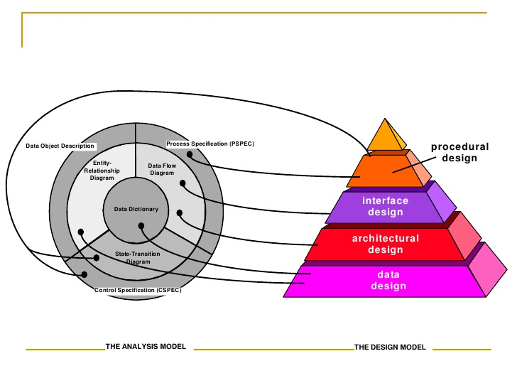
Software Design

Slide 4
Data Design
it is the first of four design activities conducted during software engineering
the impact of data structure on program structure and procedural complexity causes it to have a profound influence on software quality
its primary activity is to select logical representations of data objects (data structures) identified during the requirements definition and specification phase

Slide 5
Architectural Design
its objective is to develop a modular program structure and represent the control relationships between modules
melds program structure and data structure, defining interfaces that enable data to flow throughout the program

Slide 6
Interface Design
focuses on three areas of concern:
1. the design of interfaces between software modules
2. the design of interfaces between the software and other nonhuman producers and consumers information
3. the design of the interface between a human (the user) and the computer

Slide 7
Procedural Design
occurs after data, architectural, and interface designs have been established
constructs are composed of the following:
sequence — implements processing steps that are essential in the specification of any algorithm
condition — provides the facility for selected processing based on some logical occurrence
repetition — provides for looping
structured programming — an important procedural design technique

Slide 8
Design Concepts
Abstraction
Modularity
Software Architecture
Control Hierarchy
Structural Partitioning
Data Structure
Design Concepts
Software Procedure
Information Hiding

Slide 9
Levels of Abstraction
Procedural abstraction
named sequence of instructions that has a specific and limited function
Data abstraction
named collection of data that describes a data object
Control abstraction
implies a program control mechanism without specifying internal details

Slide 10
Refinement
Stepwise refinement is a top-down design strategy originally proposed by Niklaus Wirth
causes the designer to elaborate on the original statement, providing more and more detail as each successive refinement occurs
helps the designer to reveal low-level details as design progresses

Slide 11
Modularity
division of software into separately named and addressable components (modules) integrated to satisfy problem requirements
the single attribute of software that allows a program to be intellectually manageable

Slide 12
Software Architecture
alludes to “the overall structure of the software and the ways in which that structure provides conceptual integrity for a system”
the hierarchical structure of program components (modules), the manner in which these components interact, and the structure of the data that are used by the components

Slide 13
Control Hierarchy
also called program structure
represents the organization (often hierarchical) of program components (modules) and implies a hierarchy of control
does not represent procedural aspects of software such as sequence of processes, occurrence/order of decisions, or repetition of operations
also represents two subtly different characteristics of the software architecture: visibility and connectivity

Slide 14
Structural Partitioning
Horizontal partitioning defines separate branches of the modular hierarchy for each major program function.
Vertical partitioning, often called factoring, suggests that control (decision making) and work should be distributed top-down in the program architecture.

Slide 15
Data Structure
representation of the logical relationship among individual elements of data
as important as program structure to the representation of software architecture
dictates the organization, methods of access, degree of associativity, and processing alternatives for information
its organization and complexity are limited only by the ingenuity of the designer

Slide 16
Software Procedure
focuses on the processing details of each module individually
must provide a precise specification of processing, including sequence of events, exact decision points, repetitive operations, and even data organization/structure

Slide 17
Information Hiding
modules should be specified and designed so that information (procedure and data) contained within a module is inaccessible to other modules that have no need for such information
implies that effective modularity can be achieved by defining a set of independent modules that communicate with one another only that information that is necessary to achieve software function

Slide 18
Cohesion
cohesive module performs a single task within a software procedure, requiring little interaction with procedures being performed in other parts of a program
may be represented as a “spectrum”
A module that performs a set of tasks that relate to each other loosely, if at all, is termed coincidentally cohesive.

Slide 19
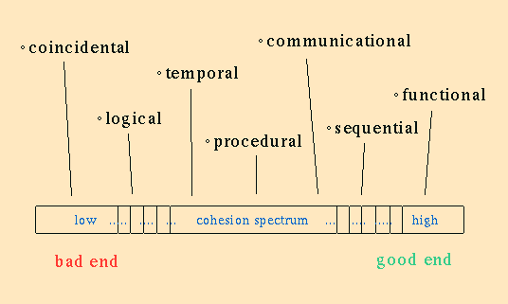

Slide 20
Coupling
measure of interconnection among modules in a program structure
may also be represented on a spectrum
depends on the interface complexity between modules, the point at which entry or reference is made to a module, and what data pass across the interface

Slide 21
